Slide 1
memory

Slide 2
What is memory?
Psychologists consider memory to be the process by which we encode, store, and retrieve information.
Each of the three parts of this definition—encoding, storage, and retrieval—represents a different process.
You can think of these processes as being analogous to a computer’s keyboard (encoding), hard drive (storage), and software that accesses the information for display on the screen (retrieval).

Slide 3
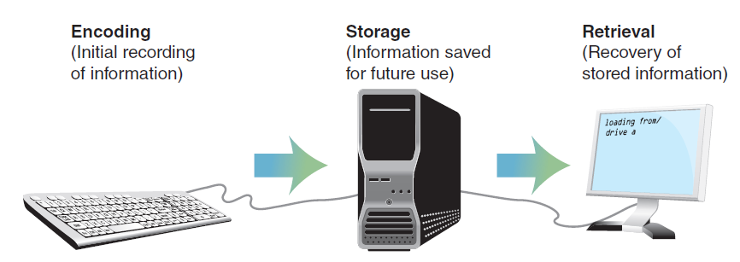
Cont.

Slide 4
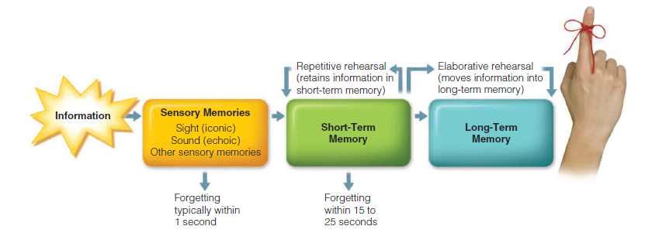
three-system approach to memory

Slide 5
Cont.
Sensory memory refers to the initial, momentary storage of information that lasts only an instant. Here an exact replica of the stimulus recorded by a person’s sensory system is stored very briefly.
In a second stage, short-term memory holds information for 15 to 25 seconds and stores it according to its meaning rather than as mere sensory stimulation.
The third type of storage system is long-term memory. Information is stored in long-term memory on a relatively permanent basis, although it may be difficult to retrieve.

Slide 6
Sensory memory
A momentary flash of lightning,
the sound of a twig snapping,
and the sting of a pin-prick
These all represent stimulation of exceedingly brief duration, but they may nonetheless provide important information that can require a response.
Such stimuli are initially—and fleetingly—stored in sensory memory, the first repository of the information the world presents to us.

Slide 7
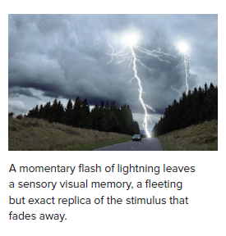
Cont.
Sensory memory can store information for only a very short time.
If information does not pass into short-term memory, it is lost for good.
Despite the brief duration of sensory memory, its precision is high:
Sensory memory can store an almost exact replica of each stimulus to which it is exposed

Slide 8
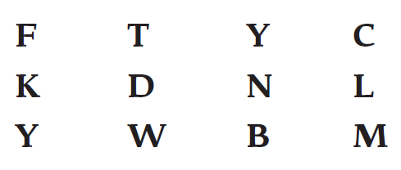

Slide 9
Cont.
It was possible, then, that the information had initially been accurately stored in sensory memory.
But during the time it took to verbalize the first four or five letters, the memory of the other letters faded.

Slide 10
Cont.
Sensory memory operates as a kind of snapshot that stores information— which may be of a visual, auditory, or other sensory nature—for a brief moment in time.
But it is as if each snapshot, immediately after being taken, is destroyed and replaced with a new one.
Unless the information in the snapshot is transferred to some other type of memory, it is lost.

Slide 11
Short term memory
Short-term memory is the memory store in which information first has meaning, although the maximum length of retention there is relatively short (Hamilton & Martin, 2007).
Because the information that is stored briefly in sensory memory consists of representations of raw sensory stimuli, it is not meaningful to us.
If we are to make sense of it and possibly retain it, the information must be transferred to the next stage of memory: short-term memory.

Slide 12
Unlike sensory memory, which holds a relatively full and detailed—if short-lived—representation of the world, short-term memory has incomplete representational capabilities.
In fact, the specific amount of information that can be held in short-term memory has been identified as seven items, or “chunks,” of information, with variations up to plus or minus two chunks.

Slide 13
chunk
A chunk is a grouping of information that can be stored in short-term memory.
For example, a chunk can be a group of seven individual letters or numbers, permitting us to hold a seven-digit phone number (such as 226-4610) in short-term memory.
But a chunk also may consist of larger categories, such as words or other meaningful units. For example, consider the following list of 21 letters:
P B S F O X C N N A B C C B S M T V N B C

Slide 14
Cont.
Because the list of individual letters exceeds seven items, it is difficult to recall the letters after one exposure. But suppose they were presented as follows:
PBS FOX CNN ABC CBS MTV NBC
In this case, even though there are still 21 letters, you’d be able to store them in short-term memory since they represent only seven chunks.

Slide 15
When does the information go to long term memory?

Slide 16
rehearsal
The transfer of material from short- to long-term memory proceeds largely on the basis of rehearsal , the repetition of information that has entered short-term memory.
Rehearsal accomplishes two things.
First, as long as the information is repeated, it is maintained in short-term memory.
More important, however, rehearsal allows us to transfer the information into long-term memory

Slide 17
When does it go to LTM?
Whether the transfer is made from short- to long-term memory seems to depend largely on the kind of rehearsal that is carried out.
If the information is simply repeated over and over again—as we might do with a telephone number someone tells us as we rush to store it in our phone—it is kept current in short-term memory, but it will not necessarily be placed in long-term memory.
Instead, as soon as we stop punching in the phone numbers, the number is likely to be replaced by other information and will be completely forgotten.

Slide 18
Elaborative rehearsal
In contrast, if the information in short-term memory is rehearsed using a process called elaborative rehearsal, it is much more likely to be transferred into long-term memory.
Elaborative rehearsal occurs when the information is considered and organized in some fashion.
The organization might include expanding the information to make it fi t into a logical framework, linking it to another memory, turning it into an image, or transforming it in some other way.
For example, a list of vegetables to be purchased at a store could be woven together in memory as items being used to prepare an elaborate salad, could be linked to the items bought on an earlier shopping trip, or could be thought of in terms of the image of a farm with rows of each item.

Slide 19
Working memory
Memory system that holds information temporarily while actively manipulating and rehearsing that information.
Example:
If you use the analogy of a computer, working memory is the processing that occurs in an open window on your desktop, as compared with the long-term storage of information in the computer’s hard drive

Slide 20
Cont.
Working memory permits us to keep information in an active state briefly so that we can do something with the information.
For instance, we use working memory when we’re doing a multistep arithmetic problem in our heads, storing the result of one calculation while getting ready to move to the next stage.
(I make use of my working memory when I figure a 20% tip in a restaurant by first calculating 10% of the total bill and then doubling it.)

Slide 21
Cont.
Although working memory aids in the recall of information, it uses a significant amount of cognitive resources during its operation.
In turn, this can make us less aware of our surroundings—something that has implications for why it’s unsafe to use cell phones while driving.
If a phone conversation requires thinking, it will burden working memory and leave drivers less aware of their surroundings, an obviously dangerous state of affairs (Sifrit, 2006; Strayer & Drews, 2007).

Slide 22
Stress and working memory
Furthermore, stress can reduce the effectiveness of working memory by reducing its capacity.
In fact, one study found that students with the highest working memory capacity and greatest math ability were the ones who were most vulnerable to pressure to perform well.
Those who should have performed best, then, were the ones most apt to choke on the test because their working memory capacities were reduced by the stress

Slide 23
Long term memory
Material that makes its way from short-term memory to long-term memory enters a storehouse of almost unlimited capacity.
Like a new file we save on a hard drive, the information in long-term memory is filed and coded so that we can retrieve it when we need it.
A primacy effect occurs, in which items presented early in a list are remembered better.
There is also a recency effect, in which items presented late in a list are remembered best

Slide 24
Long term memory modules
One major distinction within long-term memory is that between declarative memory and procedural memory.
Declarative memory is memory for factual information: names, faces, dates, and facts, such as “a bike has two wheels.”
In contrast, procedural memory (or non-declarative memory ) refers to memory for skills and habits, such as how to ride a bike or hit a baseball.
Information about things is stored in declarative memory;
information about how to do things is stored in procedural memory

Slide 25
Cont.
Declarative memory can be subdivided into semantic memory and episodic memory.
Semantic memory is memory for general knowledge and facts about the world, as well as memory for the rules of logic that are used to deduce other facts.
Because of semantic memory, we remember that the ZIP code for Beverly Hills is 90210, that Mumbai is on the Arabian Sea, and that memoree is the incorrect spelling of memory .
Thus, semantic memory is somewhat like a mental almanac of facts

Slide 26
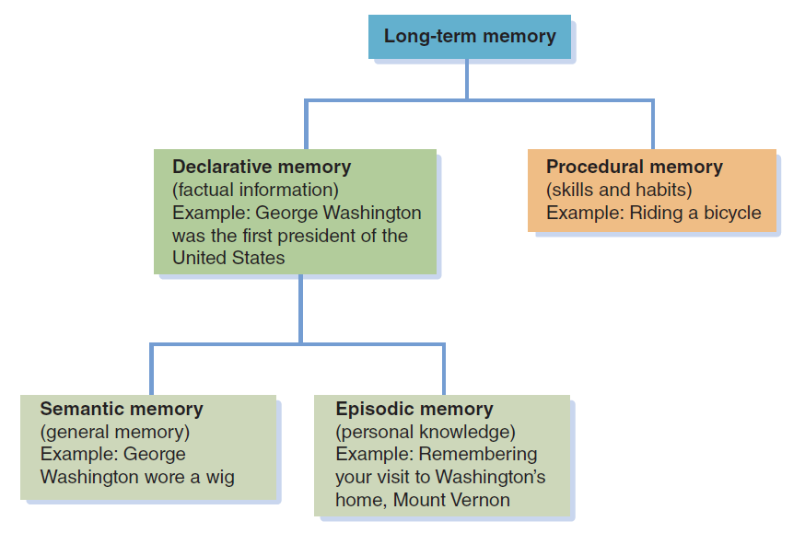

Slide 27
In contrast, episodic memory is memory for events that occur in a particular time, place, or context.
For example, recall of learning to hit a baseball, or arranging a surprise 21st birthday party for our brother is based on episodic memories.
Episodic memories relate to particular contexts. For example, remembering when and how we learned that 2 x 2 = 4 would be an episodic memory; the fact itself (that 2 x 2 = 4) is a semantic memory.

Slide 28
Cont.
Episodic memories can be surprisingly detailed.
Consider, for instance, how you’d respond if you were asked to identify what you were doing on a specific day 2 years ago. Impossible?

Slide 29
Recalling long term memories

Slide 30
Have you ever tried to remember someone’s name, convinced that you knew it but unable to recall it no matter how hard you tried? This common occurrence—known as the tip-of-the-tongue phenomenon —exemplifies how difficult it can be to retrieve information stored in long-term memory

Slide 31
Retrieval cues
If you are like the average college student, your vocabulary includes some 50,000 words, you know hundreds of mathematical “facts,” and you are able to conjure up images—such as the way your childhood home looked—with no trouble at all. In fact, simply cataloging all your memories would probably take years of work.

Slide 32
Cont.
Retrieval cue is a stimulus that allows us to recall more easily information that is in long-term memory.
It may be a word, an emotion, or a sound; whatever the specific cue, a memory will suddenly come to mind when the retrieval cue is present.
For example, the smell of halwa poori, sewaiyan, bbq may evoke memories of EID or family gatherings.

Slide 33
Cont.
Retrieval cues guide people through the information stored in long-term memory in much the same way that a search engine such as Google guides people through the Internet.

Slide 34
Recall and recognition
They are particularly important when we are making an effort to recall information, as opposed to being asked to recognize material stored in memory.
In recall , a specific piece of information must be retrieved—such as that needed to answer a fill-in-the-blank question or to write an essay on a test.
In contrast, recognition occurs when people are presented with a stimulus and asked whether they have been exposed to it previously or are asked to identify it from a list of alternatives.

Slide 35
Level of processing
The deeper the processing of information, the longer it stays in memory
Shallow; only sensory information is payed attention
Deeper: information is analyzed in terms of its meaning. We may see it in a wider context and draw associations between the meaning of the information and broader networks of knowledge

Slide 36
Implicit & Explicit Memory
Explicit memory refers to intentional or conscious recollection of information.
When we try to remember a name or date we have encountered or learned about previously, we are searching our explicit memory.
Implicit memory refers to memories of which people are not consciously aware but that can affect subsequent performance and behavior.
Skills that operate automatically and without thinking, such as jumping out of the path of an automobile coming toward us as we walk down the side of a road, are stored in implicit memory.
Similarly, a feeling of vague dislike for an acquaintance, without knowing why we have that feeling, may be a reflection of implicit memories.

Slide 37
Flashbulb memories
Flashbulb memories are memories related to a specific, important, or surprising event that are recalled easily and with vivid imagery.
Several types of flashbulb memories are common among college students. For example, involvement in a car accident, meeting one’s roommate for the first time, and the night of high school graduation are all typical flashbulb memories
Memories that are exceptional are more easily retrieved (although not necessarily accurately) than are those relating to events that are commonplace.

Slide 38
Constructive Processes in Memory: Rebuilding the Past
Constructive processes , processes in which memories are influenced by the meaning we give to events.
When we retrieve information, then, the memory that is produced is affected not just by the direct prior experience we have had with the stimulus, but also by our guesses and inferences about its meaning.

Slide 39
Cont.
Frederic Bartlett,
Schemas: Organized bodies of information stored in memory that bias the way new information is interpreted, stored, and recalled.
Understanding of the situation,
Expectations about the situation, and
their awareness of the motivations underlying the behavior of others.
Emotional meaning of experiences
Can cause partially or completely false memories

Slide 40
Autobiographical memory
Autobiographical memory is our recollections of our own life experiences.
Autobiographical memories encompass the episodic memories we hold about ourselves
We tend to forget information about our past that is incompatible with the way in which we currently see ourselves
What is the earliest memory that you can recall correctly?

Slide 41
forgetting
When memory fails

Slide 42
Why we forget?
failure of encoding
Can you remember the exact details of coin of 5 rupee?

Slide 43


Slide 44
Decay
Decay is the loss of information in memory through nonuse. T
his explanation for forgetting assumes that memory traces, the physical changes that take place in the brain when new material is learned, simply fade away or disintegrate over time

Slide 45
interference
In interference , information stored in memory disrupts the recall of other information stored in memory.
For example, if I’m trying to recall my college classmate Jake’s name and all I can remember is the name of another classmate, James, interference may be at work

Slide 46
Cont
To distinguish between decay and interference, think of the two processes in terms of a row of books on a library shelf. In decay, the old books are constantly crumbling and rotting away, leaving room for new arrivals. Interference processes suggest that new books knock the old ones off the shelf, where they become hard to find or even totally inaccessible.

Slide 47
cue-dependent forgetting
Cue-dependent forgetting, forgetting that occurs when there are insufficient retrieval cues to rekindle information that is in memory.
For example, you may not be able to remember where you lost a set of keys until you mentally walk through your day, thinking of each place you visited. When you think of the place where you lost the keys—say, the library—the retrieval cue of the library may be sufficient to help you recall that you left them on the desk in the library.
Without that retrieval cue, you may be unable to recall the location of the keys.

Slide 48
proactive interference
In proactive interference, information learned earlier disrupts the recall of newer material.
Suppose, as a student of foreign languages, you first learned French in the 10th grade, and then in the 11th grade you took Spanish. When in the 12th grade you take a college subject achievement test in Spanish, you may fi nd you have difficulty recalling the Spanish translation of a word because all you can think of is its French equivalent.

Slide 49
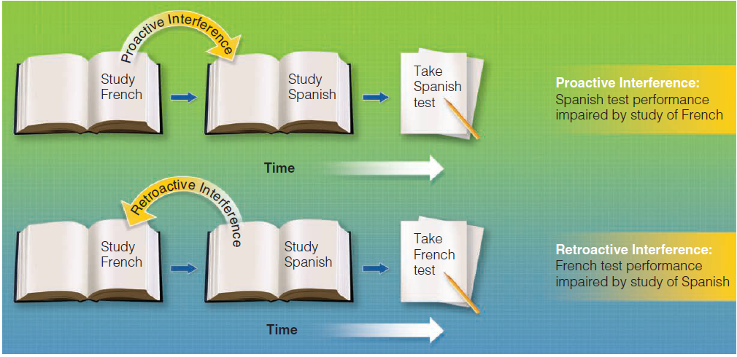

Slide 50
retroactive interference
In contrast, retroactive interference occurs when material that was learned later disrupts the retrieval of information that was learned earlier.
If, for example, you have difficulty on a French subject achievement test because of your more recent exposure to Spanish, retroactive interference is the culprit (see Figure 3).

Slide 51
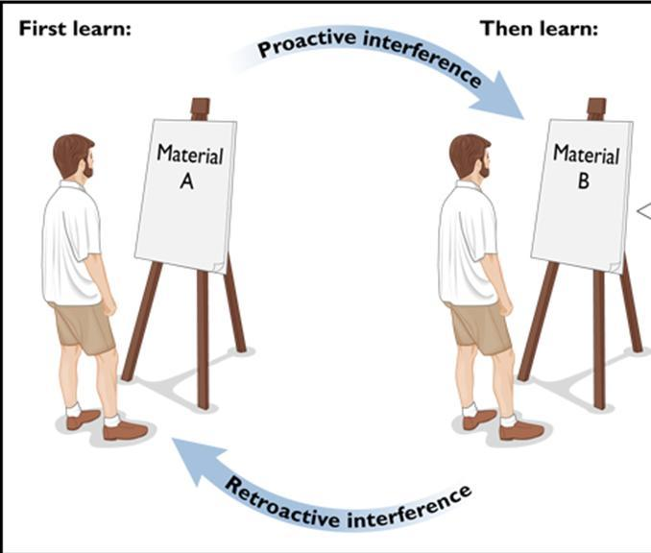

Slide 52
Memory dysfunctions
Alzheimer’s disease
A progressive brain disorder that leads to a gradual and irreversible decline in cognitive abilities.
Amnesia
Memory loss that occurs without other mental difficulties.
Retrograde amnesia
Amnesia in which memory is lost for occurrences prior to a certain event, but not for new events.

Slide 53
Cont
Anterograde amnesia, loss of memory occurs for events that follow an injury. Information cannot be transferred from short-term to long-term memory, resulting in the inability to remember anything other than what was in long-term storage before the accident
Korsakoff’s syndrome
A disease that afflicts long-term alcoholics, leaving some abilities intact but including hallucinations and a tendency to repeat the same story.

Slide 54
How to improve memory?
Use keyword technique
Rely on organization cues
Take effective notes
Practice and rehearse
Talk to yourself
Don’t believe in magic claims

